Slide 1

AGENTIC CODE REVIEW
Review that shows
its evidence
We help reviewers catch AI-written software that looks right but isn't, by showing the evidence for every finding.
Technical overview · logo is a prototype
Notes:
AI has made writing software fast, but checking it has not kept up. Where AI use is high, a review takes about five times as long. And the checking rests on very few people: in half of the ten public projects we measured, three people did more than 85% of all the reviewing. They are the bottleneck. We built a reviewer that shows its evidence, so they can check each finding instead of taking it on trust. This talk shows how it is built.

Slide 2
Cheap to write.
Flawless to look at.
Five times as long to check.
Where AI use is high:
≈5×
+31%
as long to review a change
more changes go out with no review
Faros AI, 22,000 developers, via O'Reilly: review time +441.5%, unreviewed merges +31.3%. Vendor data; a link, not a cause.
Notes:
AI has made writing software cheap. What it produces looks flawless, like a report with perfect spelling and the wrong facts, so the people checking it can no longer tell where the problems are. The strain shows: where AI use is high, checking a change takes about five times as long, and nearly a third more changes go out with no check at all. These figures come from one vendor's study of 22,000 developers; they show a link, not a cause. If an example is asked for: one tech lead's first-hand account, of an AI-written change that used an old login system while every test passed and nothing in the change looked wrong. Three sources describe this kind of hidden mistake, and none measures how often it happens.

Slide 3
Where we differ: nothing hidden, every gap reported
Tool | How a finding is checked | An unconfirmed finding
CodeRabbit | Scripts and linters in a sandbox | Filtered out
Greptile | Tests written and run in a sandbox | Not stated
Qodo | A judge agent | Filtered out
Claude Code Review | A verification step | Filtered out
Agentic Code Review | One model pass; the project's own tests next (specified) | Kept, labelled "unverified"
Sources: each vendor's own pages, read 2026-10-10. Rivals verify more than our build does today.
Notes:
Rivals verify more than our build does today: one writes and runs tests in a sandbox, another runs verification scripts, and ours makes one model pass. Our difference is narrower and it is built: a finding we cannot back is kept and labelled, where three of four rivals say they filter such findings out, and the review reports its own gaps. We have no measured catch rate yet, and our model is likely noisier than theirs.

Slide 4


Level 1: gather, review, report
1 · Context Gathering
User Provided Rules
The change, and the code around it
The project’s own standards
2 · Review
Takes the gathered context and the rules; produces findings, each tied to its evidence
3 · Reporting
Output
Turns the findings into output for people and for machines
Component design · level 1 of 3
Notes:
At the top level the reviewer is a three-stage pipeline. Context Gathering collects the change and the code around it. Review reads that context together with the project’s own rules and produces findings, each tied to the evidence it rests on. Reporting turns the findings into output. The rules sit beside the pipeline rather than inside it: they feed the review, and the link between rules and context gathering runs both ways. [Say what flows in each direction between the rules and context gathering.] The next two slides open up each box.

Slide 5



Level 2: two kinds of context
Context Gatherer
Program runtime behavior
User Provided Rules
Program static context
The project’s own standards
What the code is
What the code does when it runs
Review
Reads both kinds of context against the rules
Reporting
Output for people and for machines
Component design · level 2 of 3
Notes:
Level 2 opens the Context Gatherer. It collects two kinds of context. Static context is what the code is: the change itself and the code it touches, read without running anything. Runtime behavior is what the code does when it runs, which needs execution. The split matters because each kind costs differently and catches different mistakes: static context is cheap and always available, runtime behavior needs a runnable project and a time budget. Review and Reporting are unchanged from level 1.

Slide 6






Level 3: each part, built or not
Context Gatherer
Reporter
Program static context
User Provided Rules
Rules and patterns
Git change diff
Text reporter
AST parsers
Unit test cases
Reviewer
JSON reporter
Program runtime behavior
LLM call
GitHub PR comments
Integration / chaos testing (pre-written test cases)
Rule matching
Visual reporting
Other dynamic behavior
Solid, with a check: built, as of the 9 Oct 2026 run. Dashed: designed, not built yet. · Component design · level 3 of 3
Notes:
Level 3 shows every part. Built as of the 9 October run: the git change diff, the LLM call, and the text and JSON reporters. Everything else is designed but not built yet. In the Context Gatherer that is the AST parsers, unit test runs, integration and chaos testing against the project’s own pre-written test cases, and other dynamic behavior. In the Reviewer it is rule matching, along with the user-provided rules it reads. In the Reporter it is GitHub pull-request comments and visual reporting. This is why the MVP run shown at the end reports that no checks were run and no related context was gathered: today a review is the diff plus one model pass. [Say which part is built next.]

Slide 7
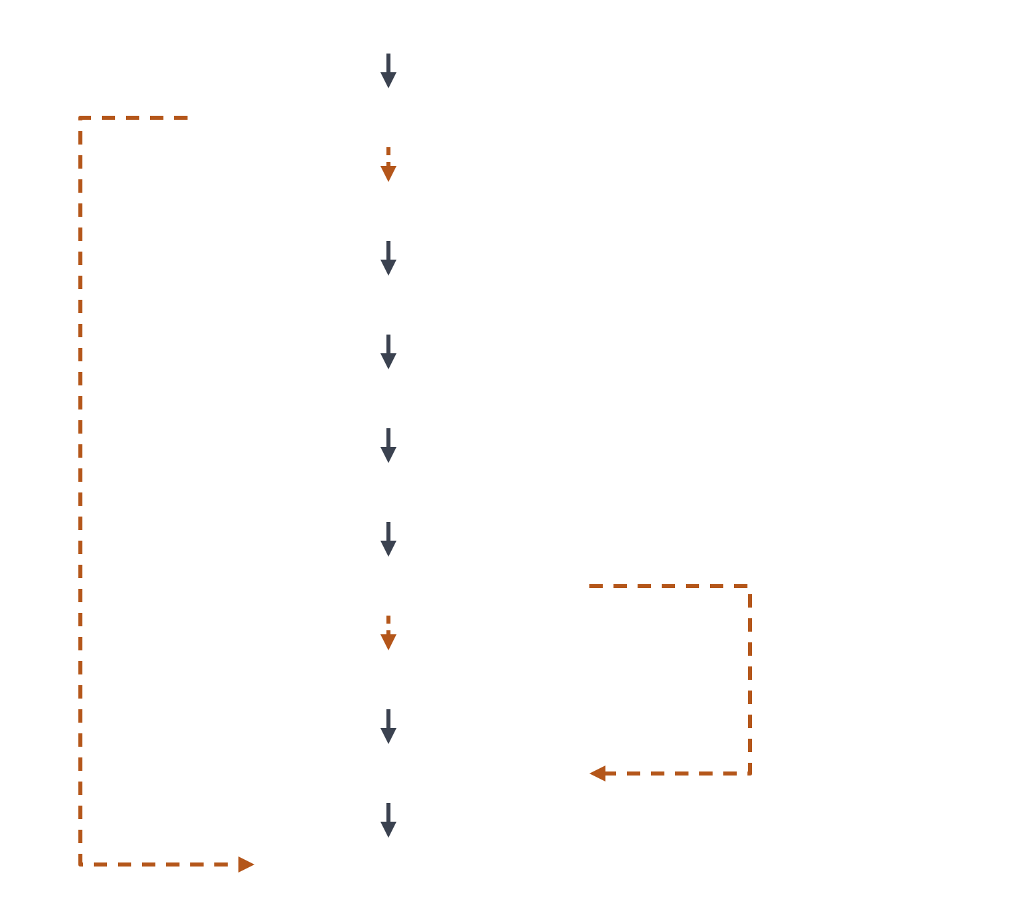
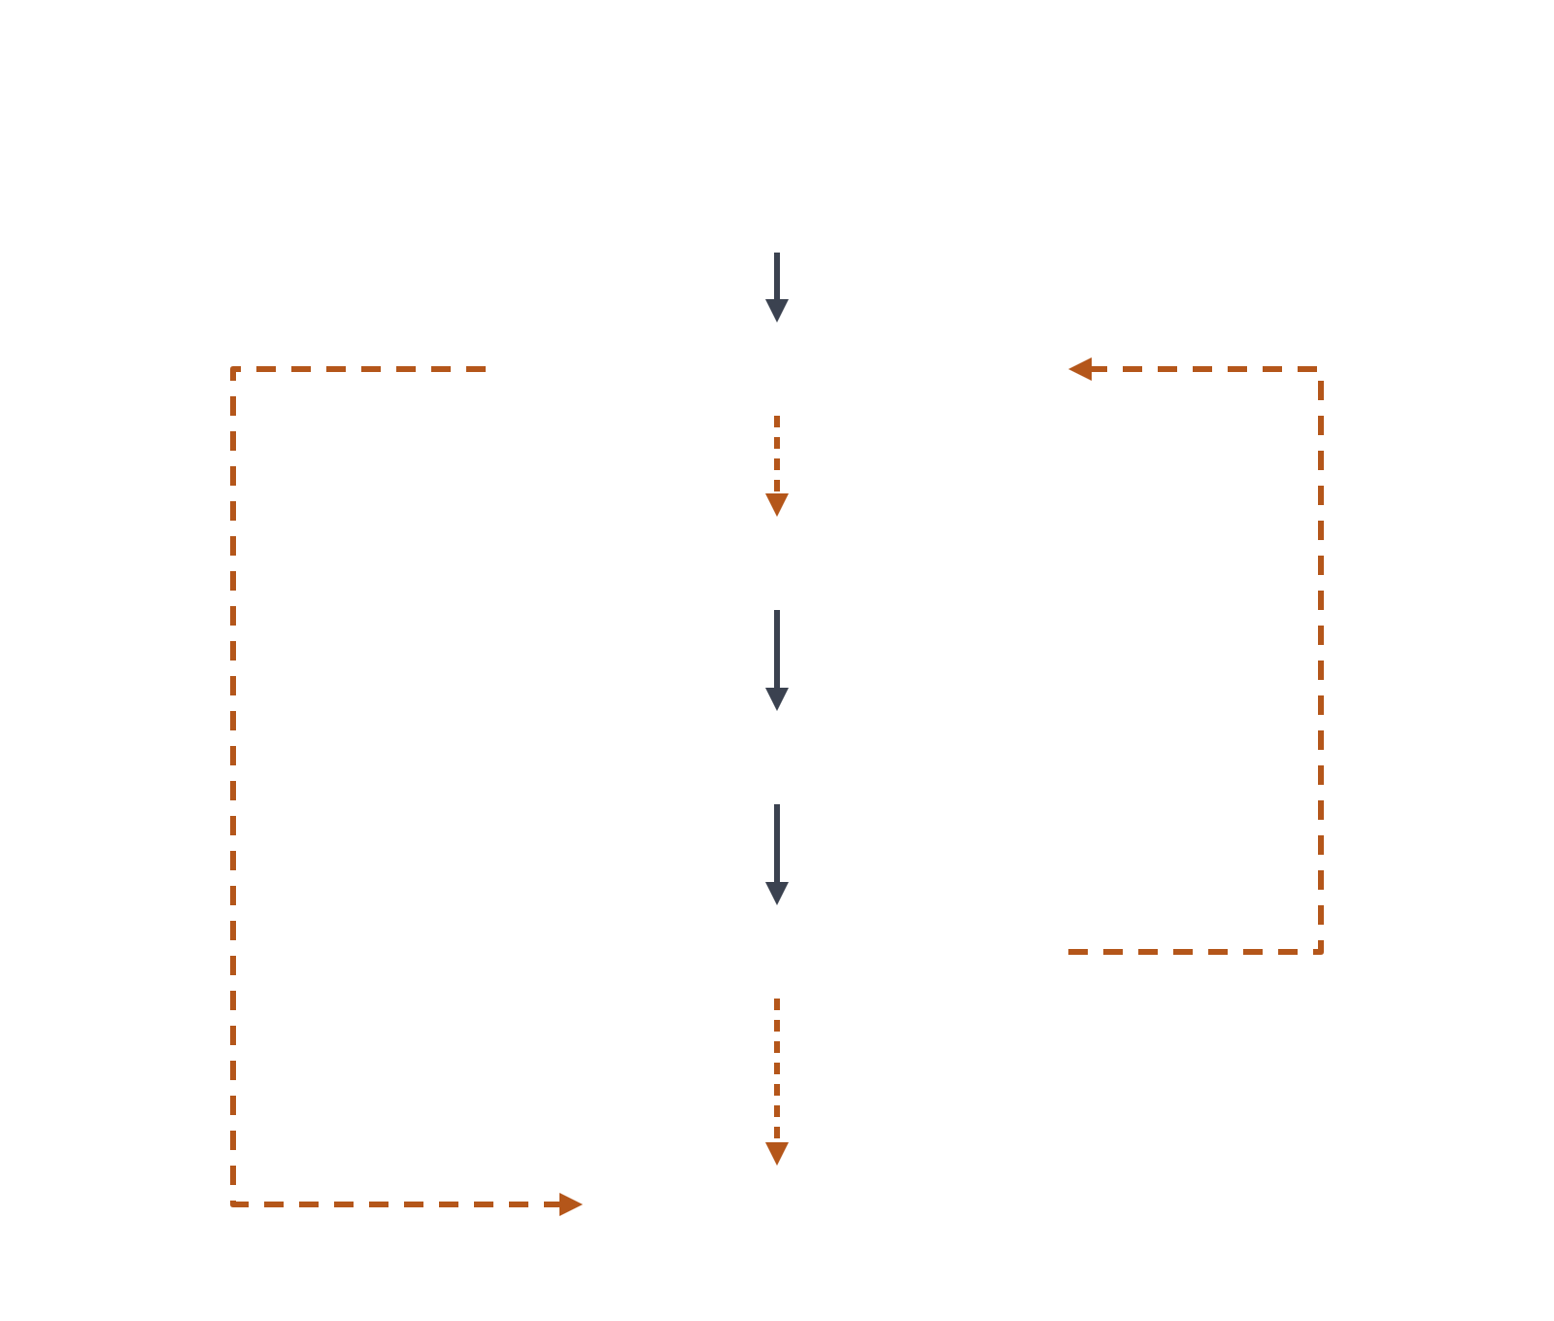
LangGraph: the graph that runs
__start__
PIPELINE GRAPH
INSIDE review_agent
preflight
continue
__start__
resolve_change_set
call_model
parse_and_context
execute_checks
validate_calls
end
load_patterns
record_coverage
end
assemble_context
review
decide_repair
review_agent
skip_review
build_report
end
__end__
__end__
Solid: fixed edge. Dashed, orange: conditional edge, labelled with its route. The green node opens up on the right.
Notes:
This is the actual LangGraph graph, as the code defines it. On the left is the pipeline. Preflight runs first and either ends the run or continues. On continue, the run resolves the change set, parses it and gathers context, executes checks, loads the patterns, and assembles the context. Assemble_context then routes one of two ways: to the review agent, or on skip_review straight to build_report. Either way, the run ends after build_report. On the right is the subgraph inside review_agent. Call_model either ends or hands its output to validate_calls. Record_coverage runs next, and decide_repair either loops back to call_model for another pass or ends. [Say what triggers skip_review, and what decide_repair checks before looping back.]

Slide 8
Stack: what runs
PACKAGE
VERSION
ROLE
pydantic
2.13.5
Finding model, report schema, config validation
pyyaml
6.0.3
Config parsing
typer
0.27.2
CLI, with click 8.5.0
rich
15.0.0
Terminal rendering
langchain-core
1.6.3
Tool binding, messages
langchain-openai
1.6.2
OpenAI-compatible provider client
langgraph
1.2.11
Review-step graph (CF-6 only)
openai
3.14.1
Transitive; its APIError hierarchy is mapped to provider-error
langfuse
5.0.1
Tracing and observability of model calls
Python. Versions as pinned in the project’s dependency list; Langfuse is the newest addition.
Notes:
The tool is written in Python. Pydantic carries the data that matters most: the finding model every component speaks, the report schema, and config validation, with PyYAML parsing the config file. Typer, on top of Click, gives the command line, and Rich renders the terminal output. Model calls go through LangChain: langchain-core for messages and tool binding, langchain-openai as the client for any OpenAI-compatible provider, which is what keeps the provider swappable. LangGraph runs the review-step graph, in CF-6 only. The openai package comes in transitively; its APIError hierarchy is mapped onto our own provider-error so a provider failure is reported, not crashed on. Langfuse is the newest addition: it traces model calls so we can see prompts, outputs, latency and cost per review. [Say what Langfuse is used for today.]

Slide 9
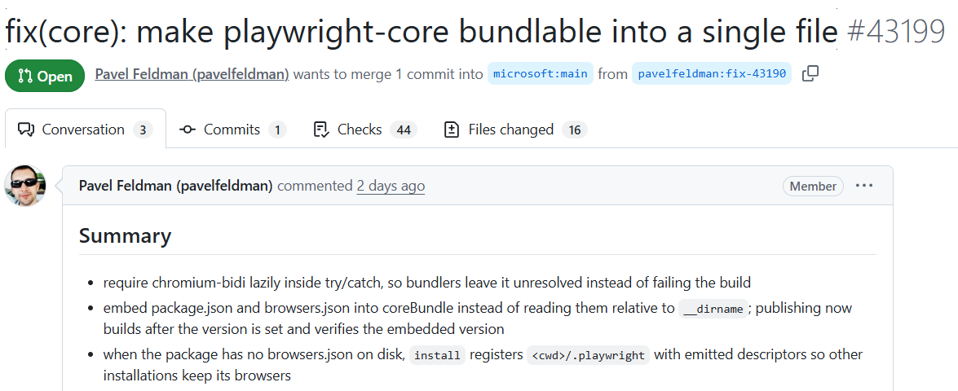

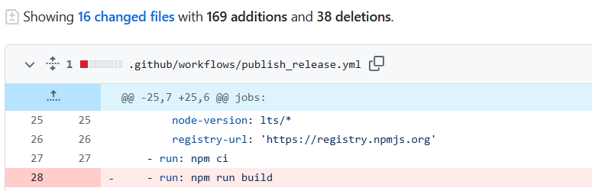

Every finding shows its evidence
$ agentic-review review --pr https://github.com/microsoft/playwright/pull/43199
INPUT · THE PULL REQUEST ON GITHUB
OUTPUT · WHAT THE TOOL REPORTED
16
files
10
reviewed
6
listed, not reviewed
nit
correctness
lines 49–53
evidence: diff hunk 1
packages/playwright-core/src/server/registry/index.ts
… calculateSha1(installationLinkTarget()) … will evaluate differently if process.cwd() differs between install and uninstall when bundled, leaving orphaned .links files.
Its own caveats. No checks were run and no related context was gathered in this build. No finding call named 9 of the 10 reviewed files.
Verdict: findings, none blocking
125.4 s, including the clone
Run 2026-10-09; the finding is unconfirmed by maintainers. Next: the project's own tests and rules as evidence (specified, not built).
Notes:
A developer runs one command and reads the findings. This is a real pull request on Microsoft's Playwright, open when it was reviewed and since closed without merging: one commit, 169 lines added and 38 removed across 16 files. The command read it from GitHub by its address and reviewed the ten TypeScript and JavaScript files in about two minutes, clone included, in one model pass. What you see is built: the finding carries its location, its severity and the part of the diff it rests on, and the review says what it did not do, here that no checks ran, no related context was gathered, and nine of the ten files got no finding call. Evidence from the project's own tests and type-check, and from the project's own rules, is specified and not built; nothing is posted on the pull request yet, which comes in version 3. We have not confirmed the finding with Playwright's maintainers. The run was made from the project notebook, which makes the same call as the command shown.

Slide 10
Team members
Mohammed Gamal Kenawy
Mahmoud Ayman Mahmoud
Mohamed Ali Mahmoud
Team leader · Junior engineer
Junior software engineer
Senior Oracle developer
Ahmed Shahin
Abdelrahman Ehab
Yahia Ahmed Hamed
Sales manager
Junior software engineer
Junior software engineer
Notes:
We are four junior software engineers, a senior Oracle developer and a sales manager, and Mohammed Gamal Kenawy leads the team. If asked: the repository's history shows one author so far.

